Slide 1
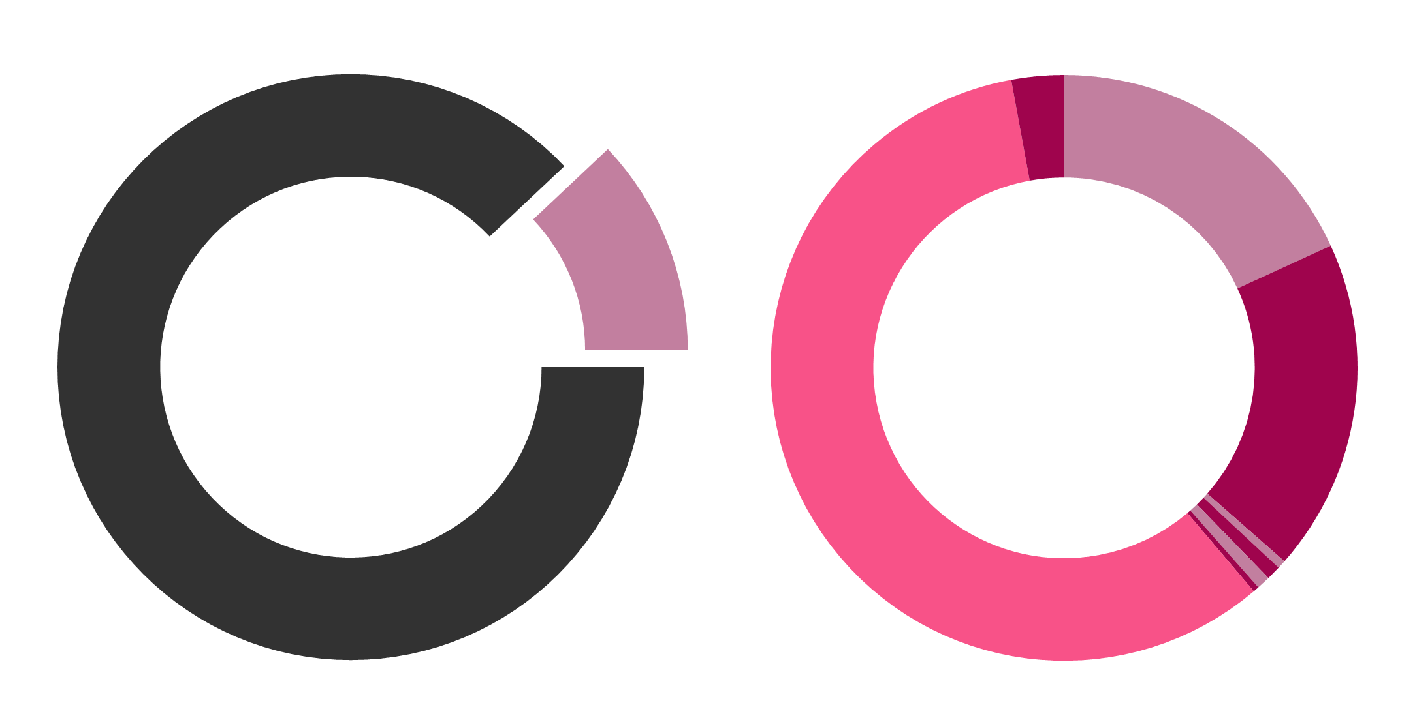
Other 62 (2.9%)
LRRK2 Het.: 387 (18%)
Biallelic: 3 (0.1%)
PRKN Het.: 357 (16.6%)
Biallelic: 37 (1.7%)
Positive 2,149 (12%)
GBA1 Het.: 1,239 (57.7%) Biallelic: 14 (0.7%)
DJ1 Het.: 10 (0.5%)
Biallelic: 0 (0%)
PINK1 Het.: 11 (0.5%)
Biallelic: 6 (0.3%)
SNCA Het.: 16 (0.7%)
Biallelic: 0 (0%)
Negative 15,715 (88%)
VPS35 Het.: 7 (0.3%)
Biallelic: 0 (0%)

